Slide 1
Character Design
CS 4730 – Computer Game Design
Mark Floryan

Slide 2
Topics
Character Design:
Choosing a set of moves, thinking about risk vs reward of that move set
State machines for programming characters
What makes controlling a character fun?
How does the environment and narrative of the game play into a character’s control?

Slide 3
Character Design

Slide 4
Controllable Characters
Starting Simple. Most controllable characters have a set of actions. Game designers often refer to these as verbs.
Mario: Run, jump, shoot fireballs
later: fly, splash water, throw hat, etc.
Samus: Run, jump, shoot
Many of these power up: high jump, multi-jump, charge up shot, etc.
Madeline (Celeste): Run, jump, dash

Slide 5
Controllable Characters
Some tips on designing verbs:
Try to limit the number of necessary verbs. Provide more interesting ways to use them if possible.
We will see many examples of this in a moment
There should be one controller action per verb
Always consider the goal/purpose of your game and how that verb helps the player reach that goal.

Slide 6
Controllable Characters
4 Examples
Mario (Super Mario Bros.)
Mega Man (Mega Man 3)
Samus (Super Metroid)

Slide 7
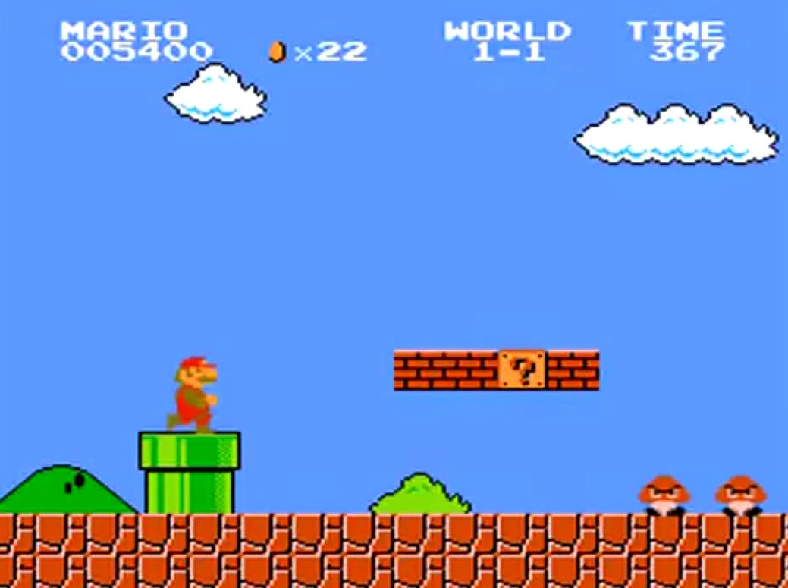
Mario (Super Mario Bros.)

Slide 8
Mario (Super Mario Bros.)
What is Mario’s goal?
Save the princess? Well, kinda
Really it is “get to the end of the level” (go right)
What are Mario’s verbs?
Walk/Run (left and right): Helps Mario go right!
Jump (over obstacles and enemies)
Fireballs (if flower obtained)

Slide 9
Mario (Super Mario Bros.)
Let’s look at Mario’s run
Run has three phases:
Speed up time, max speed, slow down time
Features of Mario’s run:
very slow speed up and slow down speed. Controlling Mario feels a bit like he is on ice
speed up and slow down speeds MUCH slower while Mario is in the air.
What ”feel” does this give to Mario?

Slide 10
Mario (Super Mario Bros.)
Mario’s Jump:
Slow to reach top speed
Total jump height is pretty high
These two make the jump feel high but “floaty”
Quicker to reach top speed when falling

Slide 11
Mario (Super Mario Bros.)
Overall Design Principles of Mario:
The ground gives more control than air
Need to use ground when possible to establish control
Being in the air feels risky
Jumps are high and slow. Control left/right is slow
Allows time to setup landings on platforms / enemies
All of this gives Mario a strong risk vs reward tradeoff in his well thought out controls

Slide 12
Mega Man (Mega Man 3)

Slide 13
Mega Man
What is Mega Man’s goal?
Reach end of level (go right, down, up, etc.)
Destroy boss of each level (shoot at them)
What are Mega Man’s verbs?
Run: Move left and right
Jump: Jump over gaps and enemies
Shoot: blast enemies and obstacles
Slide: Not necessary, but used to increase speed.

Slide 14
Mega Man
Let’s look at Mega Man’s run and jump
Run has three phases:
Speed up time, max speed, slow down time
Features of Mega Man run:
VERY quick to top speed
Jump instantly at top speed (as far as I can tell)
Can control in air instantly
What different kind of feel does this produce? Why does this make sense?

Slide 15
Mega Man
Overall Design Principles of Mega Man:
Platforming / movement provides VERY tight control
Good for movement during a fight
Good for lining up shots
Good for avoiding enemies that are attacking
Slide provides risk vs. reward
Very quick movement, but you lose control of MM
Emphasis on control and the shooting / fighting aspect of the game.

Slide 16
Samus

Slide 17
Madeline (Celeste)

Slide 18
Some Final Thoughts
Think about the “feel” of your character, and design a minimum set of verbs for them.
Notice that most of these characters get powerups in the respective games but it never changes the verbs!
Think about how to parameterize controls based on this “feel” you are going for.
Notice that these rules still apply to non-platformers. How about FPS, or RPG??

Slide 19
Implementation
How best to implement? State machine useful!
States:
Standing
Jumping (in air)
Dashing
Transitions between states
When land on platform, enter standing state.
When hit by enemy, enter invincibility state
Code each state independently.

